Slide 1

COMMUNICATION PLAN: THE CHECKLIST
Analysing the context
Projecting yourself
Define my plans
Tips
Who are the targets?
How can my strengths contribute to my image?
Which communication tools best promote my activity to my targets?
What are my constraints?
What should be done about the threats?
How can I seize the opportunities?
How can I play on my company's strengths, weaknesses and values?
How can I communicate?
What are my objectives in communicating?
What is my budget?
Which actors can help me?
How can I evaluate my actions?
Remaining consistent
Prioritising my actions
Moving at my own pace
Arbitrate according to my resources

Slide 2
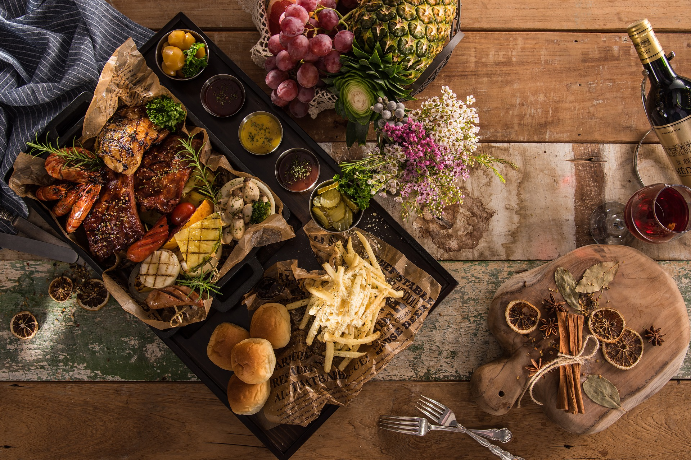
9 TIPS TO STAY INSPIRED
Setting goals
Making projects
Identifying Inspiring Entrepreneurs
Discussing with peers
Tracking progress
Taking breaks
Talking about your successes
Having a hobby
Staying on standby

Slide 3

THE COMMUNICATION PLAN ....
1
OBJECTIVES
Example 1: Opening my structure
Example 2: Getting to know me
10 IDEAS TO PROMOTE YOUR FOOD BUSINESS
Get listed on online food platforms
Create a Facebook page
Share your achievements on Instagram
Get listed in directories and guides
Make a virtual showcase via Google My Business
Make a Google site
Establishing partnerships at local level
Create a blog
Approach companies
Set up a loyalty programme
The communication plan is the framework that will evolve along with your project. You need it for :
Spreading your messages
Being credible
Creating links
This is the second stage of your strategy .
2
TARGETS
Example 1: 50 local customers for the opening
Example 2: With two companies within 2 months
3
ACTIONS
Example 1: Creating a Facebook page
Example 2: Creating an event
10 ideas to promote your food business
COMMUNICATION PLAN
(Download the checklist and the communication plan to be completed)

Slide 4
5 IDEAS FOR EVENTS TO LAUNCH YOUR ACTIVITY
Organise culinary demonstrations
Make a video to share on social networks
Create culinary animations
Propose a thematic tasting
Offer a foodtrip or foodtour

Slide 5
5 IDEAS TO PUT IN MOUTH ON SOCIAL NETWORKS
Share your photos on Instagram
Make surveys of your recipes on Facebook
Sharing stories and reality
Create videos to show your achievements
Showcasing your products, your materials, your dishes

Slide 6
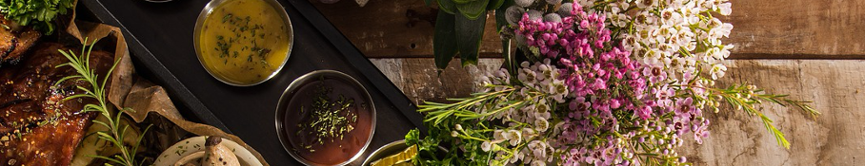






Site editors
WIX
SITE GOOGLE
WORDPRESS
JIMDO
MY E-SITE
Good product, but very intrusive logos are present.
Good interface, easy to use
Complex use for beginners
Serious product. Offers assistance.
The only publisher that displays banner ads

Slide 7
FOCUS.... PRINT FOOD
PRINT FOOD OR FOOD PERSONALISATION
It is the transfer of printing solutions applied to the feed. Screen printing, inkjet printing, transfer, hot stamping, laser engraving... Printing techniques are at the service of food products.
Used in pastry and chocolate making, print food is widespread. These sectors have a strong marketing dimension. This technique makes it possible to extend the brand image, the signature right up to the plate.

Slide 8
PREVENTING AND MANAGING A CRISIS....
CRISIS COMMUNICATION
You need to manage your photos and opinions posted on social networks. Get trained on the subject as soon as possible.
PREVENTING THE CRISIS
Encouraging satisfied customers to give you feedback
Propose a contact/complaint form
Provide detailed content
MANAGING THE CRISIS
Reply to all comments
Report abusive comments
Highlighting positive comments
Appealing to your community

Slide 9
LE PITCH .... EXAMPLE
Juan is the founder of the Bionuestro food truck. He is pitching to a food packaging company, which offers a parking area. The company wants to give its employees a varied fast food offer. Juan is going to pitch to a prospect using the common values of their project. Source de Juan : Company website .
"Hello, Juan Candela, founder of the Bionuestro food truck.
XX's locavorous products... they are at the heart of current events, at the heart of ethics and above all at the heart of our business! It is urgent to consume differently. I sublimate the products of XX through my kitchen xxx. A fusion cuisine, which retraces my journey as a globetrotter in love with traditions xxx. In this way, I make you discover my xxx culture through your products. My project is part of the circular economy, the future for our professions! I make the taste buds of companies such as xxx wriggle, and you will see my creations on several social networks.
I am sure that my dishes will delight your employees. Together, we can create the responsible consumption of tomorrow. »

Slide 10
STORYTELLING .... EXAMPLE
Juan is the founder of the Bionuestro food truck. He has to present his entrepreneurial career in front of a class of young high school students.
"I used to tick all the boxes of the impossible, yet today I am the founder of the Bionuestro food truck.
I arrived here xx years ago. I learned the language xxx.... I learned to cook by watching my mother. So it was when I discovered the locavorous products that I had the idea of sharing my culture. In my foodtruck I share my culture every day. I don't have a diploma, I have travelled to several countries and I have not had a home. Creating an activity was unimaginable to me, but thanks to XXX I found a new reason to wake up in the morning...".

